Slide 1
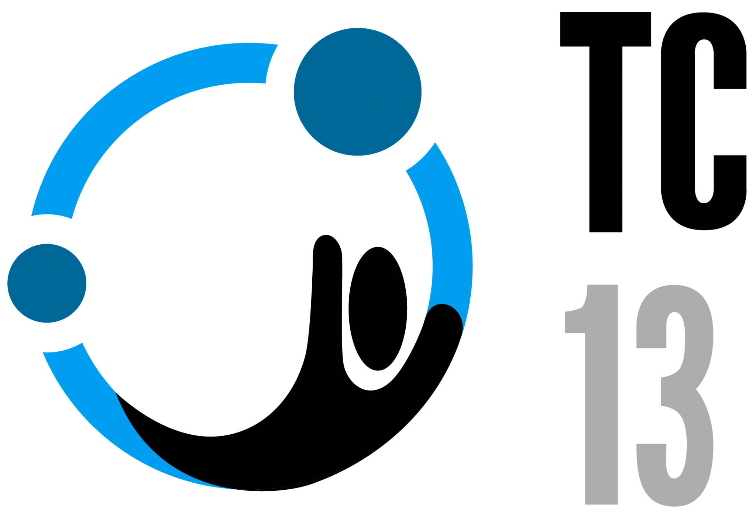

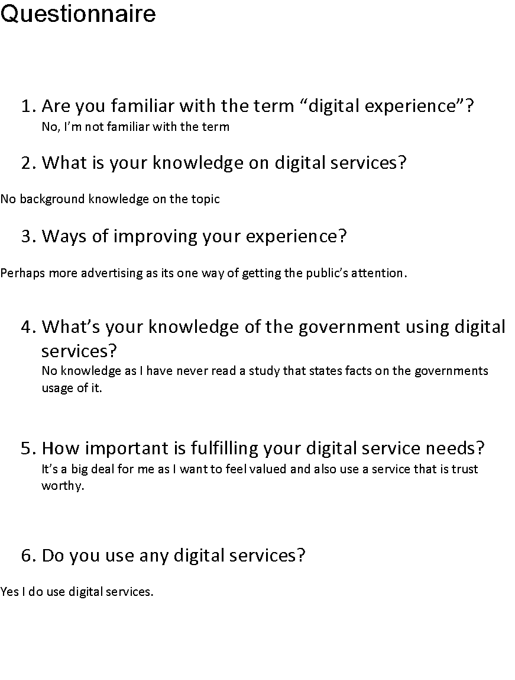
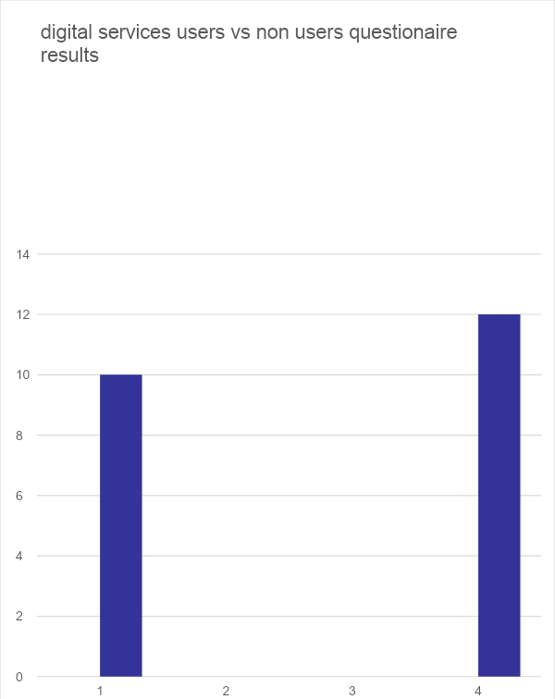
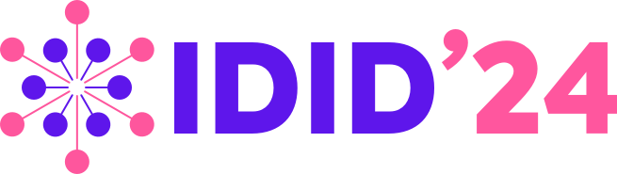
Poster Title
Carl Sagan
21341069@student.uwl.ac.uk
Abstract
Methodology
I have done research for this project and one-to-one interviews to get some sort of result to give me a clear understanding digital experience for everyone. For this study I will be discussing the ways of how a user can improve their digital experience. I will be displaying more in depth information on digital services and how they can be improved for users. I will do this by designing a questionnaire and have a one-to-one interview with people regarding digital services and to understand what users require for their own experiences.
I will be carrying out qualitive as a research method. Reason being Is because this allows me to take in factual data which will be from real users. It helps me to know what content as well as research is expected of me from the public instead of me guessing. It also prevents answers from bots online which wouldn’t reflect what would need to be researched. Qualitive research- relied on data obtained by the researcher from first-hand observation, things such as interviews and questionnaires are used for accurate results. The data is generally nonnumerical Quantitative is the process for collecting data and analysing numerical data. It can be used for finding patterns and averages, making predictions and testing casual relationships. As part of my research, I will be using questionnaires to help obtain information from students for how they think their digital experience can be further developed. I will also be asking them regarding their experience with digital experience and if it’s something they would investigate for the future.
Introduction
I will be developing a researched based study on how a user’s digital experience can be used and the type of methods that I know are suitable for this topic. The research method is an important piece for this study as it allows me to go in depth with each method that will be used for this project. I will also be introducing ways that a company can make a huge impact on a customer’s experience as well as how a company should start to a start their digital project. To my knowledge it was brought to my attention that the importance of digital experience cannot be ignored as it can be the future of technology seeing as its value is forever growing in the technology industry, I want to welcome users who have a personal interest in digital experience as it will help the community in ways that haven’t displayed. I intend to bring along my ideas and share the appropriate knowledge regarding a user’s digital experience. This research hall is not age restricted meaning all ages are welcome to have a browse if they’re curious or interested. I have a great knowledge for research and gaining the correct figures for backing up valid points. I will be showcasing these skills to back up my statements for how a user’s digital experience can be further upgraded.
Results
Results gain from the questionnaire. The graphs displays the number of users who have used digital services against those who have not shown the results of the questionnaire in which was filed out by different users. I also engaged with students in my university for a one-to-one interview to gain more information as to what research should be taken seriously and what to avoid. I have displayed a bar chart below which shows the number of user who have used digital services against those who have not.
This helped for the final pieces to my research as I obtained knowledge from the users. The above image displays the engagement received from my questionnaire. It shows the non-users against users who are familiar with using digital services. This helps to expand my research further seeing as I can see what the public has experienced and develop my knowledge on that. This model was designed using Microsoft excel, a software that is trustworthy and popular to the community.
Aims and Objectives
The aim of this research is ensuring that users know how to use public services and ways that it can impact their lives for the better. I would like to introduce the ways of how the government use public services to benefit themselves and the community to research on how to improve a. users digital experience as well as carry out further research on how the government uses it. The objective of this project is to create a questionnaire and have 1 to 1 interview with people and their views of digital public services are and round up and collect the information that has been given to me and round up a final result and conclude what the public audience make of digital services.
.
Conclusions
For improving a user’s experience, I find that you would need to measure it with methods such as heatmaps, designing surveys, user experience testing and interviews. These methods all help for contributing towards a better experience for the public and ones that have accurate results. The results from my questionnaire allowed me to structure my research into my final stages before finalising my documents. What I was looking to accomplish is to give the public more information on digital services than what has already been displayed to the public. For my research I was unable to gather information regarding the government as they are very private on releasing their own information to the public.
References
B. (2022). 9 Ways To Improve Digital Customer Experience. [online] The CX Lead. Available at: https://medium.com/the-cx-lead/9-ways-to-improve-digital-customer-experience-272659848782.
www.mckinsey.com. (n.d.). The future of work: A government blueprint | McKinsey. [online] Available at: https://www.mckinsey.com/industries/public-and-social-sector/our-insights/a-government-blueprint-to-adapt-the-ecosystem-to-the-future-of-work.
www.hanrec.com. (n.d.). 5 Challenges of Public Sector Digital Transformation Hanover. [online] Available at: https://www.hanrec.com/blog/2020/02/5-challenges-of-public-sector-digital-transformation?source=google.com [Accessed 12 Jun. 2022].

